Slide 1

Green Pace
Security Policy Presentation
Developer: Eleanor Shamble

Slide 2

OVERVIEW: DEFENSE IN DEPTH
Notes:
Hello, this is my policy recommendation. Defense in depth is essential, as multiple layers of security make issues less and less likely. I included some developer styling guidelines as well, to reduce technical debt.

Slide 3
THREATS MATRIX
Code Styling Issues Overflow | SQL Injection Overflow Privilege Abuse
Code Styling Issues | Privilege Abuse SQL Injection
Notes:
I’ve listed some potential security risks based off what is addressed in my recommendations.
Code Styling issues covers uncommented code, badly named variables, et cetera. This is within your control, so I would consider it to be unlikely, and it is lower priority than active security risks.
Overflow I would consider likely due to user input, and high priority because it can have an impact on the program’s memory.
SQL Injection, unlike Overflow, requires a user to be malicious and have technical knowledge so I would consider it a less likely issue, but it is a big threat because it can wipe an entire database.
Privilege abuse is bad behavior from high ranking users (for example, admins). This is less likely, but incredibly threatening.

Slide 4
10 PRINCIPLES
Principle | Coding Standards
Validate Data | STD-004-INJ, STD-005-MRY, STD-003-STR, STD-001-DTY
Heed Compiler Warnings | STD-005-MRY, STD-007-ESC, STD-009-RDN
Architect and Design for Security Policies | STD-004-INJ, STD-005-MRY, STD-003-STR, STD-008-COM
Keep It Simple | STD-003-STR, STD-009-RDN, STD-010-NAM, STD-002-DTV, STD-006-ASR
Default Deny | STD-004-INJ
Adhere to the Principle of Least Privilege | STD-004-INJ
Sanitize Data Sent to Other Systems | STD-004-INJ, STD-005-MRY, STD-003-STR
Practice Defense in Depth | STD-004-INJ
Use Effective Quality Assurance Techniques | STD-006-ASR
Adopt a Secure Coding Standard | STD-004-INJ, STD-005-MRY, STD-007-ESC, STD-003-STR, STD-008-COM, STD-009-RDN, STD-001-DTY, STD-010-NAM, STD-002-DTV, STD-006-ASR
Notes:
My principles are as follows: validate data, heed compiler warnings, architect and design for security policies, keep it simple, default deny, least privilege, sanitize data, defense in depth, effective quality assurance, and a secure coding standard. Each of these principles has one or more coding standards associated with it, as shown here.

Slide 5
CODING STANDARDS
Number | Name | Severity
STD-004-INJ | Minimize the risk of SQL Injection in user input. | 1
STD-005-MRY | Ensure that your code does not trigger overflow. | 1
STD-007-ESC | Ensure that your code has exception handling. | 2
STD-003-STR | Use std::string instead of char arrays. | 3
STD-008-COM | Thoroughly comment your code. | 3
STD-009-RDN | Avoid repetitive code. | 3
STD-001-DTY | Correct use of integers. | 4
STD-010-NAM | Choose practical variable and function names. | 4
STD-002-DTV | Sensible bools. | 5
STD-006-ASR | Use assertions instead of cout when debugging code. | 5
Notes:
Here are my ten standards in priority order, from highest to lowest priority. Minimizing SQL injection risk, preventing overflow, exception handling, using std::string, comments, avoiding repetitive code, using integers correctly, using practical names for variables and functions, using accurate names for Booleans, and using assertions in unit tests.
To rank these, I ranked them from very unlikely to high for likelihood, low to high for cost, and low to high for priority. From there, I assigned a number from 1 as the highest severity to 5 as the lowest severity, based on the combination of those factors. My assessment of likelihood, cost, and priority are in the report.

Slide 6
ENCRYPTION POLICIES
Encryption at rest - Encrypt sensitive information before it enters the database.
Encryption in flight - Encrypt sensitive information as it travels from the database to the user.
Encryption in use - Data should remain encrypted while it’s in use, and should be encrypted when it’s entered.
Notes:
Encrypt sensitive information before it enters the database. Encryption at rest is encryption of any data that isn’t currently in use- so data in the database. Passwords, emails, et cetera should be encrypted because they’re personal information. If there is a data breach, hackers will need to attempt decryption of the data to access it.
Encrypt sensitive information as it travels from the database to the user, or from the user to the database. Encryption in flight is encryption of moving data. While data is traveling between the system and the user it should remain encrypted. For example, a user’s information should remain encrypted when traveling through the network. This ensures that the data is not intercepted.
Data should remain encrypted while it’s in use, and should be encrypted when it’s entered. Encryption in use is encryption of any data that’s currently being processed. For example, when comparing the entered password to the stored password to confirm a user can log in, both the entered password and stored password should remain encrypted. This prevents users from accessing data they shouldn’t.

Slide 7
TRIPLE-A POLICIES
Authentication – User/administrator account information. 2+FA.
Authorization – The principle of least privilege.
Accounting – Track user data.
Notes:
Authentication. Users should have usernames, passwords, and additional security (such as PINs or 2 factor authentication), and should be able to create accounts if they don’t already have one. Administrators should also have usernames, passwords, and additional security. Authentication ensures that a user’s information is stored, so that their account and activity is associated with them. This is important for any application that requires specific people to be identified. For example, browsing on Wikipedia doesn’t require user authentication, but editing a Wikipedia page does, because Wikipedia may need to ban people who make offensive and inaccurate edits.
Authorization. The principle of least privilege should be applied when enabling permissions for users. For example, a basic user should not be able to access or change the account information of other users. Users should have roles in accordance with the least amount of privileges that they need to fulfill their specific User Stories.
Accounting. User data should be tracked so that administrators can remove or restrict users that are not behaving appropriately. Data collection should be limited to what is strictly necessary for the application’s functionality and moderation. Accounting is the tracking of relevant user data, and this is important for any application that wants to ensure that users aren’t abusing the application.

Slide 8
Unit Testing
Google Test
Notes:
The following slides have example Google Tests. Google Tests are perfect for testing the typical cases and edge cases of a function, covering as many scenarios as reasonably possible. Google Tests should be written for every function, and the application should be as close to 100% test coverage as possible. No common or hazardous scenarios should be left out of testing.
One enormous benefit of unit tests is that they only need to be written once, and they can be run quickly afterward as many times as needed. This way, developers do not need to manually test if everything still works after making a tweak to the code, the Google Tests will tell them.

Slide 9
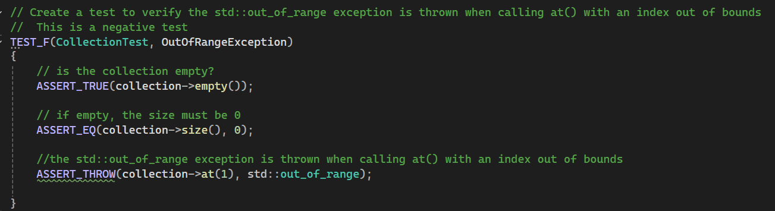
Exception Throwing
Notes:
This test verifies that an exception is thrown when an index is out of bounds in a collection.

Slide 10
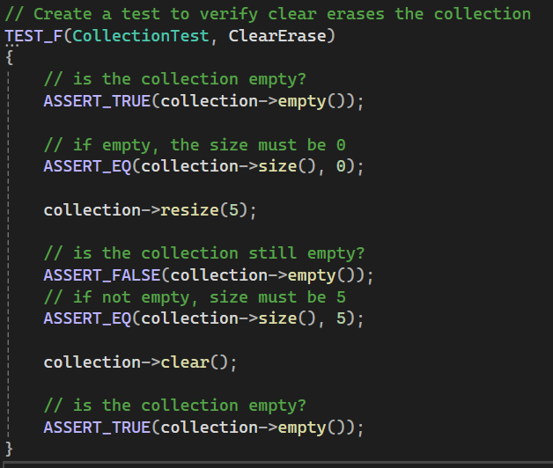
Clear Erase
Notes:
This tests that a collection can be populated and then erased.

Slide 11
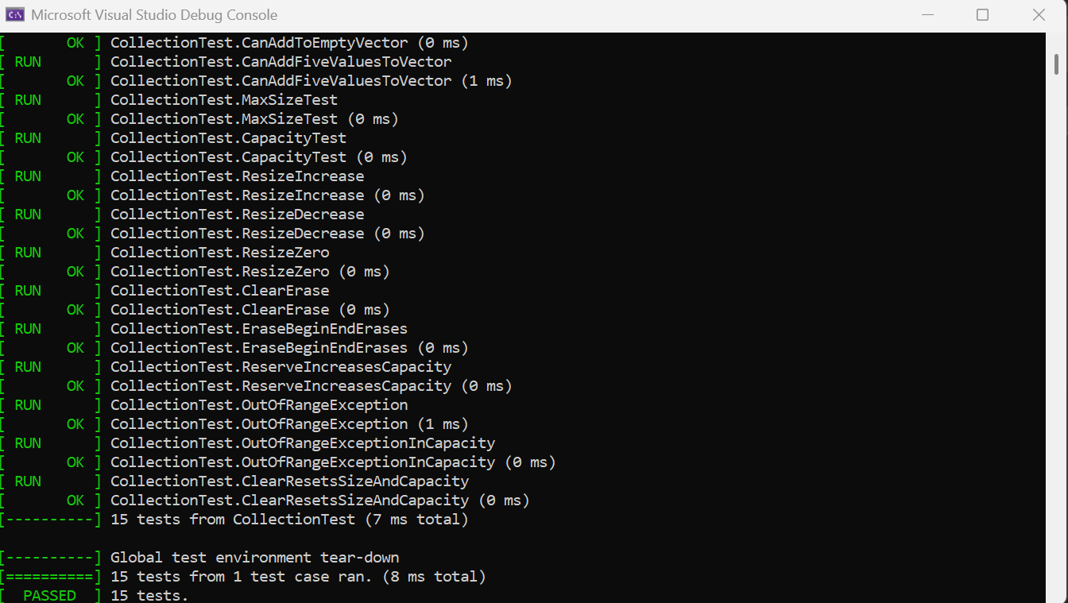
Output Example
Notes:
Here is an example of the Google Test output. You can see a list of tests and whether they passed, and the number of tests passed. As you can see, all of the tests are run at once, and in this case, the result was instantaneous.

Slide 12

AUTOMATION SUMMARY
Notes:
Testing will occur throughout the displayed DevSecOps process. I would not recommend using automation (artificial intelligence) during the assess and plan and design phases, as AI can hallucinate and produce unwanted results. While coding, human reviewers need to thoroughly test all AI code. The code will compile many times during the Build stage- IDEs such as Visual Studio have built in compilers that developers will use while coding before they do formal tests. During the verify and test phase, there may be unit testing, systems testing, et cetera. The transition and health check phase includes deployment, where a tool like Jenkins could be used to sanity check the code right before it goes to production. Monitor and detect is all automated- the collection of logs is automated, event alerting is automated, and intrusion detection is automated. Responses can be semi automated, but humans will need to decide what response is appropriate for what scenario. Maintaining and stabilizing can look like returning to a sane build, which can be done through GitHub.

Slide 13
RISKS AND BENEFITS
Benefit: Reduced tech debt
Risk: Increased development time
Benefit: Less security flaws to exploit
Hole: Specific technology
Notes:
Tech debt for security accumulates incredibly fast. For my style recommendations, there very well may be tech debt already. Uncommented code is tech debt, for example, and not every developer remembers to comment their code. The more you delay, the more difficult it will be to patch issues down the line.
Thorough security requires thorough coding. Patience is required to ensure that developers properly test all their code before it hits production. Sometimes this may mean delays, especially if management around a project does not understand how long a user story will take.
If code is tested well and often, there will be less vulnerabilities down the line, which could potentially save the company thousands of dollars and an enormous amount of trust.
My policy recommends Jenkins, Google Test, and Cppcheck. Other tools may be more appropriate if the organization has a very specific coding standard, or if automation in other areas is desired.

Slide 14
RECOMMENDATIONS
Specific software
Specific guidelines on Unit Testing
Addressing more potential threats (phishing, bad user behavior).
Notes:
This policy has some gaps. As stated previously, some tweaks may need to be made to the policy’s software recommendations to align with the organization’s specific interests.
The policy does not go into detail on the amount of unit test coverage needed, unit test naming guidelines, et cetera. The only standard set is that assertions need to be used within them. This policy is broad- it may be good to create a policy entirely for testing.
The threats this policy addresses are non exhaustive. There could be phishing attempts through email in the organization, and you could deal with malicious employees and malicious users, for example. The Triple-A policy should always be heeded so that other threats won’t be a problem.

Slide 15
CONCLUSIONS
More robust unit testing standards
Security for Green Pace employees
Monitoring threats other companies experience
Notes:
So, here are some additional recommendations.
As I stated, it may be appropriate to have a report exclusively for unit testing so that every test follows very strict style guidelines, and developers know how much coverage is required.
Every employee for Green Pace should be security trained and there should be guardrails so that there are less internal threats, purposeful or not.
It’s important to stay in the loop about what other companies are experiencing, so that Green Pace can ensure that we don’t have the same vulnerabilities.

Slide 16
REFERENCES
Fortinet. (2023). What Is Authentication, Authorization, And Accounting (AAA) Security? Fortinet. https://www.fortinet.com/resources/cyberglossary/aaa-security
Rowinski, M. (2021, July 22). Data Encryption: How to Protect Data in Transit, Data in Use and Data at Rest | Mimecast Blog. Mime01mstr6a4a2prod.dxcloud.episerver.net. https://www.mimecast.com/blog/data-in-transit-vs-motion-vs-rest/
‌Vicente, V. (2026). Risk Assessment Matrix: Overview and Guide. Optro.ai. https://optro.ai/blog/what-is-a-risk-assessment-matrix
Notes:
And here are my references.

